Slide 1
Wake County Board of Education - Interlocal Agreement with Town of Morrisville & Wake Technical Community College - Lease with Town of Morrisville For Fire Station Site: - First Amendment to Cedar Fork ES Joint Use Agreement with Town of Morrisville
Betty L. Parker
WCPSS Real Estate Services Senior Director
October 4, 2022

Slide 2
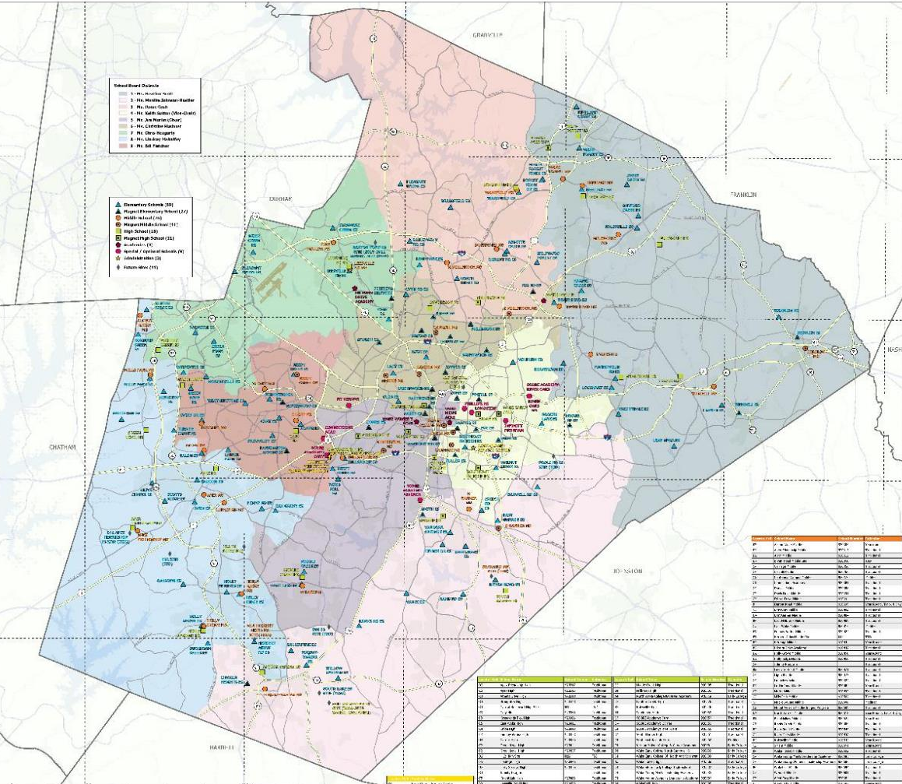
High School Target: Western Wake County/Morrisville Area

Slide 3
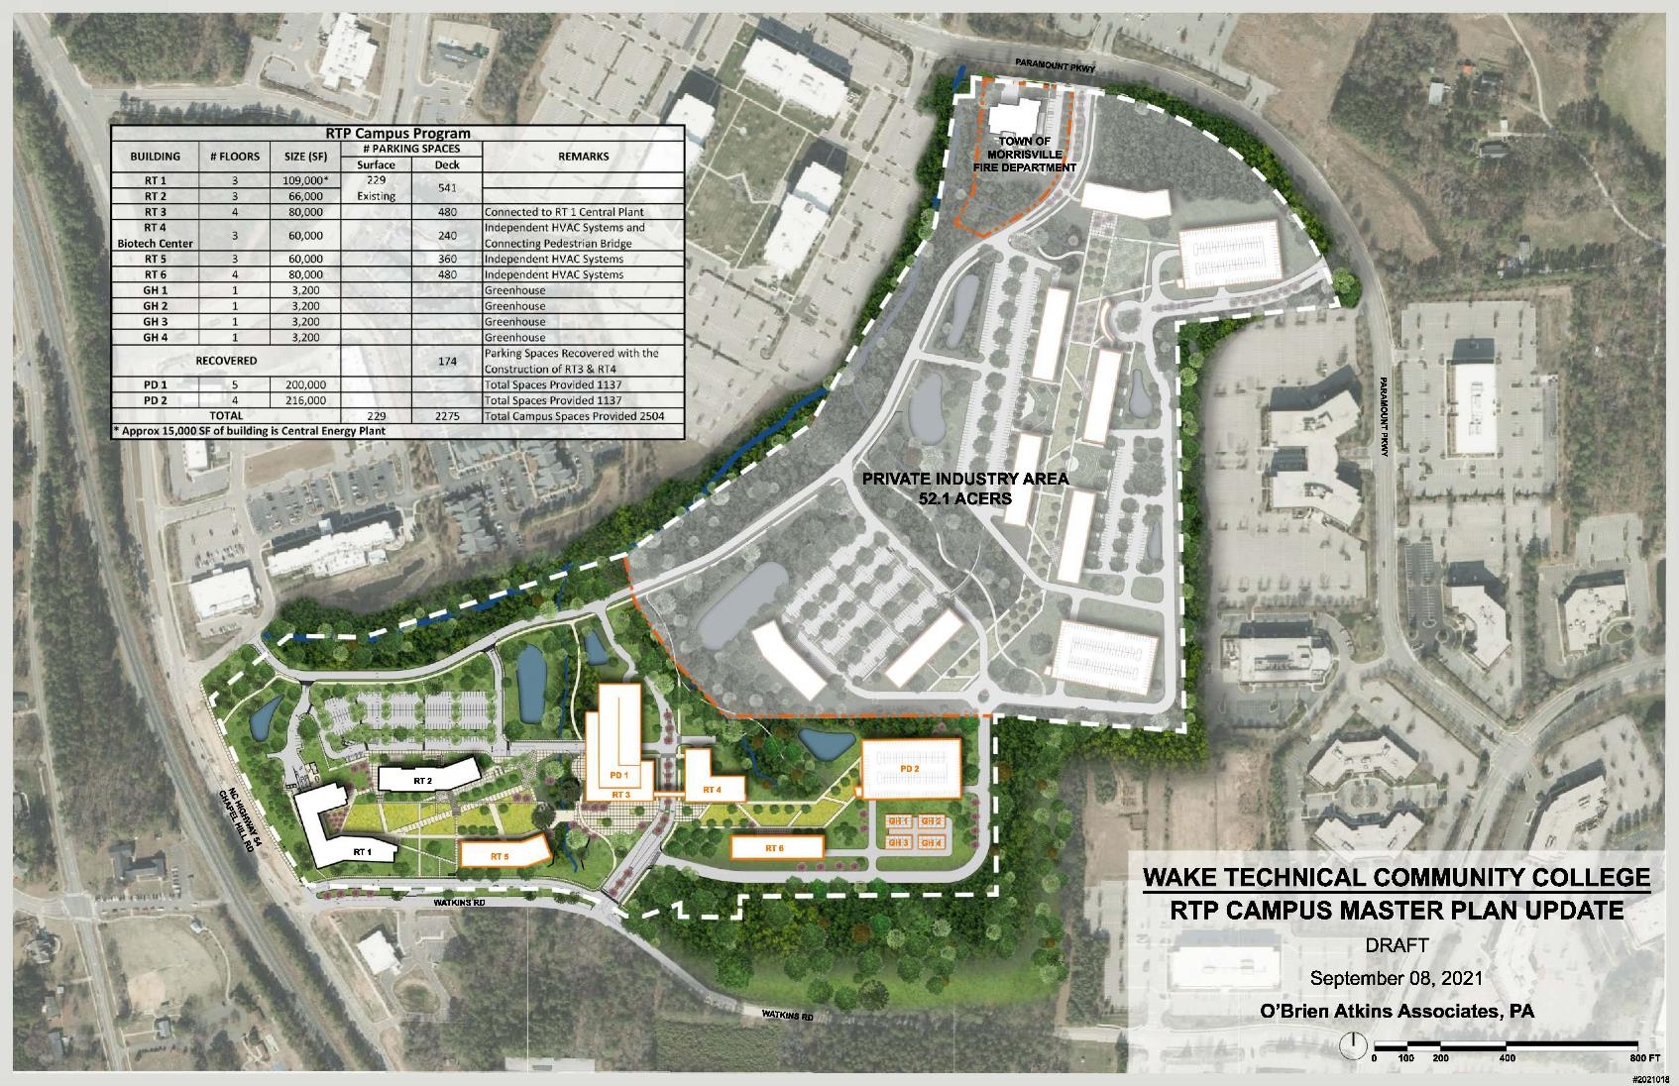
Wake Technical Community College (WTCC) RTP Campus
Airport Overlay Boundary

Slide 4
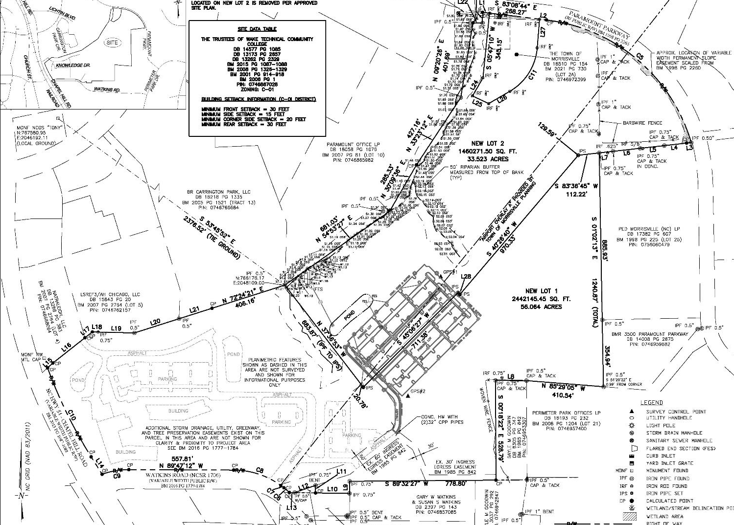
Proposed H-14 High School Site at WTCC RTP Campus
Town of Morrisville Fire Station Site
± 2.5 acres
H-14 Future High School Site
33.523 acres
WTCC RTP Campus
Airport Overlay Boundary

Slide 5
Town Fire Station Site Exchange and Future Park Locations
Town Fire Station Site
± 2.5 acres
Future Town Fire Station Site
H-14 High School Site
33.523 acres
Future Town Park Land
± 17.34 acres
WTCC RTP Campus
Airport Overlay Boundary

Slide 6
Preliminary Feasibility Study
School Site Acquisition:
WTCC – 33.523 acres
Town – 2.50 acres
(Fire Station Site)
School Site Program
(Per Feasibility Study)
High school building
1,000-1,200 students
Circulation Drives
Parent queuing space
Parking lots
Bus parking lot
Multipurpose Field
Outdoor basketball court
Competition Field
Stadium
Stormwater devices
Connection to WTCC
Connection to Town Park
(SITE ACREAGE NOTED INCLUDES ±2.5 ACRE FIRE STATION TRACT
Morrisville Leases:
WTCC – ±17.30 acres
BOE – ±2.5 acres
(Future Fire Station Site)

Slide 7
Cedar Fork ES Site – High School Program/JUA Opportunities
Softball Field
Tennis Courts
Drive & Parking Access
Restrooms/Storage Building

Slide 8
Mills Park/Mills Park ES & MS - High School Program/JUA Opportunities
Baseball Field
Drive and Parking Access
Restroom/Storage Building

Slide 9
End of First Reading Presentation
End of First Reading Presentation.
Questions?

